Slide 1
Manifest Destiny
Manifest Destiny is the belief that the United States is meant to expand to the Pacific Ocean. It began during Andrew Jackson’s presidency and ended in the mid 1800s. Many U.S. citizens migrated west for an opportunity at a better life.

Slide 2
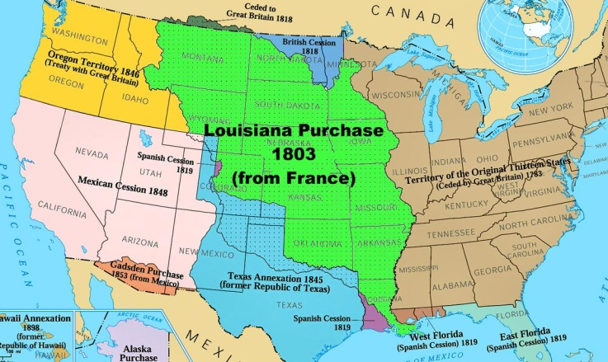
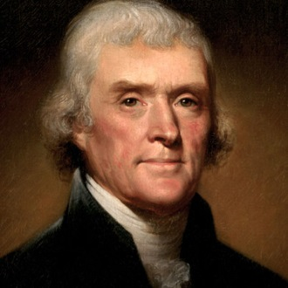
Louisiana Purchase
President Thomas Jefferson bought the Louisiana territory from France for $15million.
Napoleon was distracted with other world events, that he easily sold the land to the United States.

Slide 3
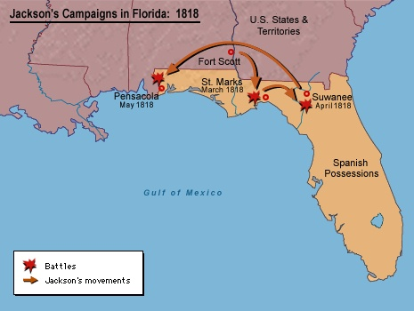
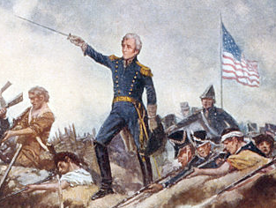
Spanish Cession
In 1818, General Andrew Jackson invaded Florida with 3,000 soldiers.
Spain did not want to risk war with the U.S.
In 1821, John Q. Adams negotiated the Adams-Onis Treaty and Spain agreed to give Florida to the U.S. for $5million.

Slide 4
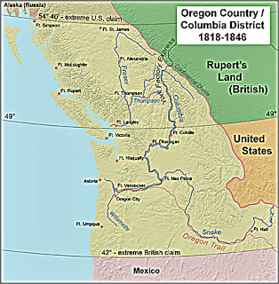
Oregon country
• 4 countries competed for Oregon
Country (U.S., England, Spain,
Russia)
•1818 - U.S. and Great Britain agreed
to jointly occupy Oregon
•1846 - U.S. and Great Britain
compromised
a line was drawn at 49°N latitude
U.S. got all land south
Great Britain got all land north

Slide 5
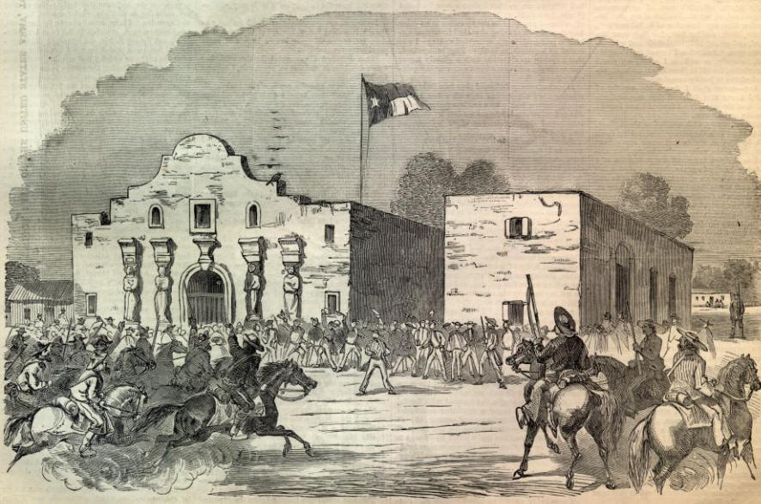
Texas annexation
• 1836 - Texas wins war with Mexico and gained their independence
They were known as the Lone Star Republic
• Texas wants to join the U.S. but the U.S. in unsure because of the slavery issue.
• 1845 - Americans agree to annex Texas to the U.S.

Slide 6
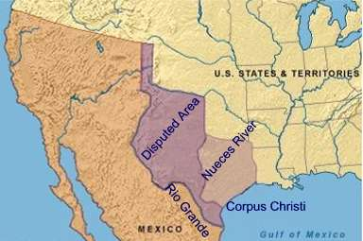
Mexican cession
• U.S. offered to buy the land from
Mexico for $30 million - Mexico
said no
• a dispute over the southern
border of Texas started the
Mexican War
U.S. believes the border is the Rio
Grande, Mexico believed it was
the Nueces Rv (200 miles north)
• Treaty of Guadalupe-Hidalgo ends the Mexican war and the U.S. agreed to pay $15 million for the Mexican Cession

Slide 7
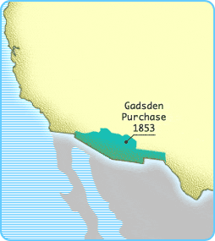
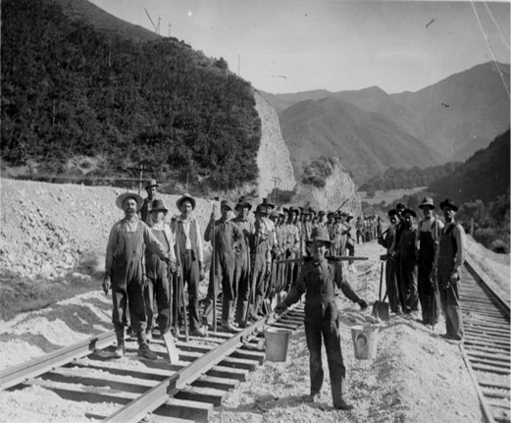
Gadsden Purchase
• The United States
bought the Gadsden
Purchase to complete
the building of the
Southern Pacific
Railroad, a trans-
continental railroad
in the South.
• This officially
completed
Manifest Destiny.

Slide 8
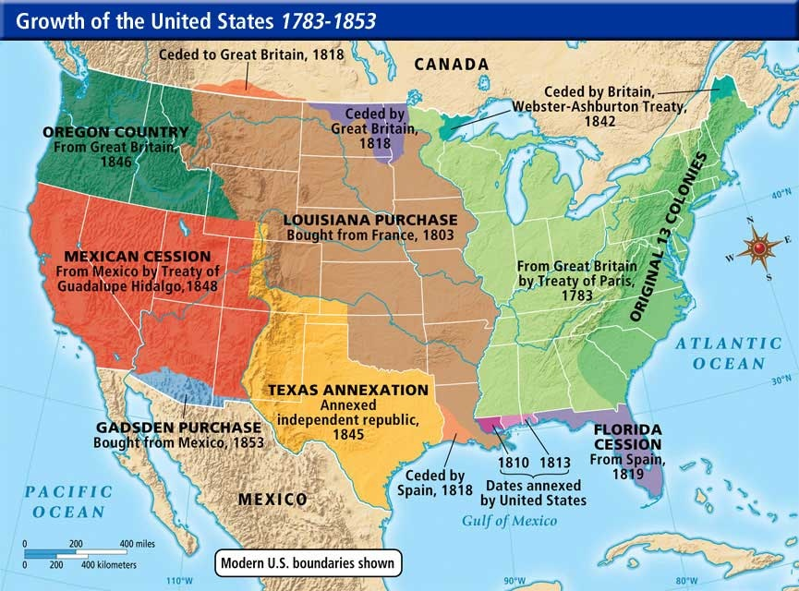
From sea to shining sea…

